Slide 1

Sweet Karolines Cakes Analysis
By: Silver Soul
Benjamin Benoit, Nick Gay, Matt Holston, Alex Mattingly, Adam Schweitzer, and Nick Taylor

Slide 2




Problems
Karoline would like to…
Create more customer contacts
Streamline customer interactions
Automate her business to increase efficiency
Integrate an online ordering and payment system

Slide 3
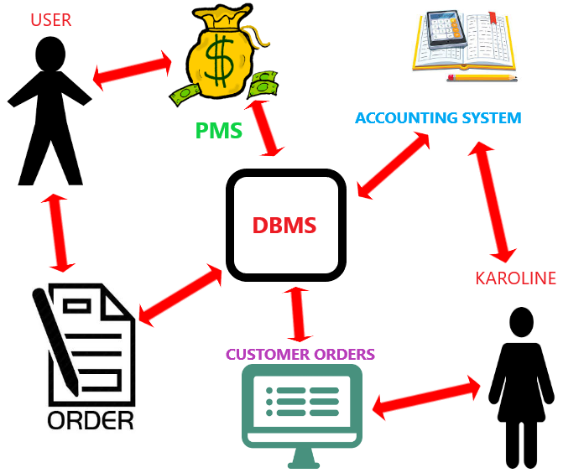
Process System

Slide 4

Process System Components
Payment System: Paypal
Web Domain: GoDaddy
Antivirus Software: Avira
Accounting System: Quicken
Content Management System: ExpressionEngine
ExpressionEngine comes with a built in database and web-store, while also being easy to learn.
Notes:
Yeah don’t know if we should add a slide for the cms or not...

Slide 5
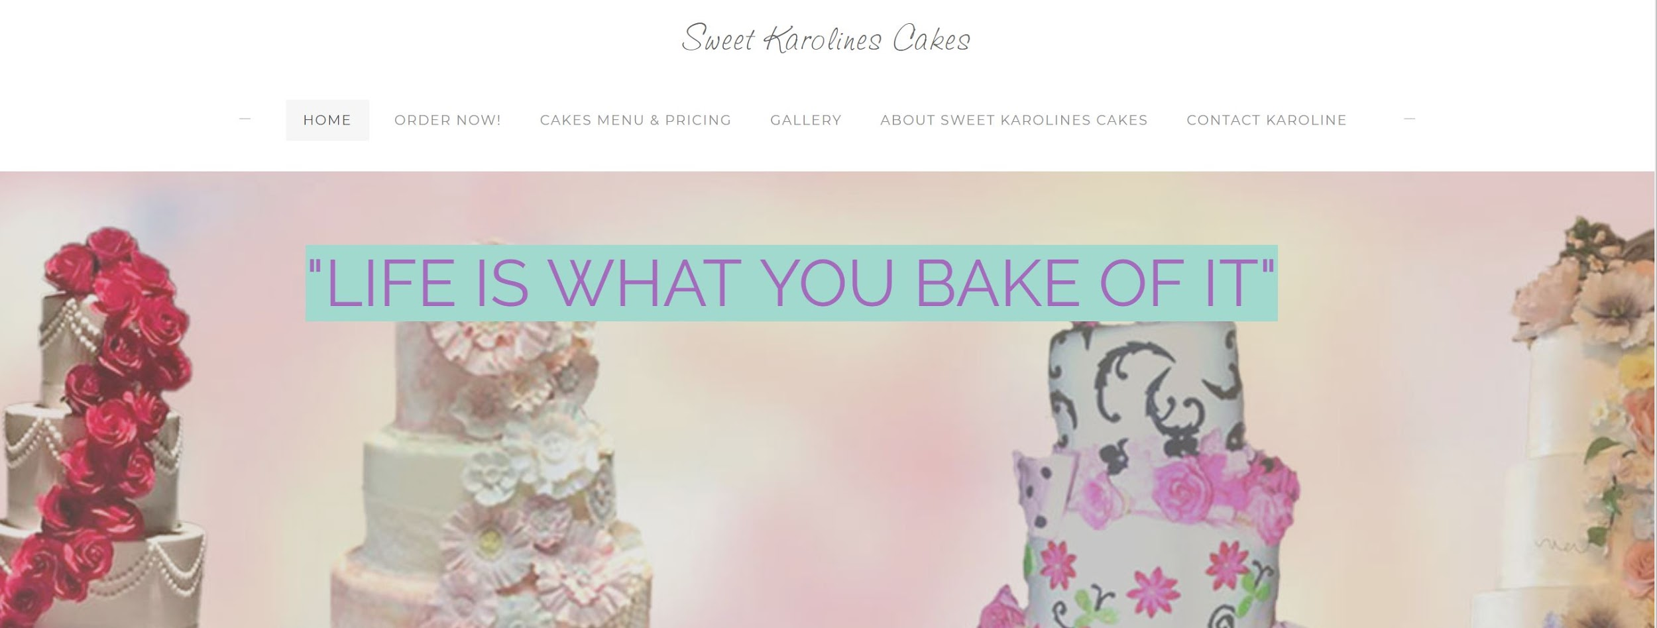
Prototype - Home Page

Slide 6
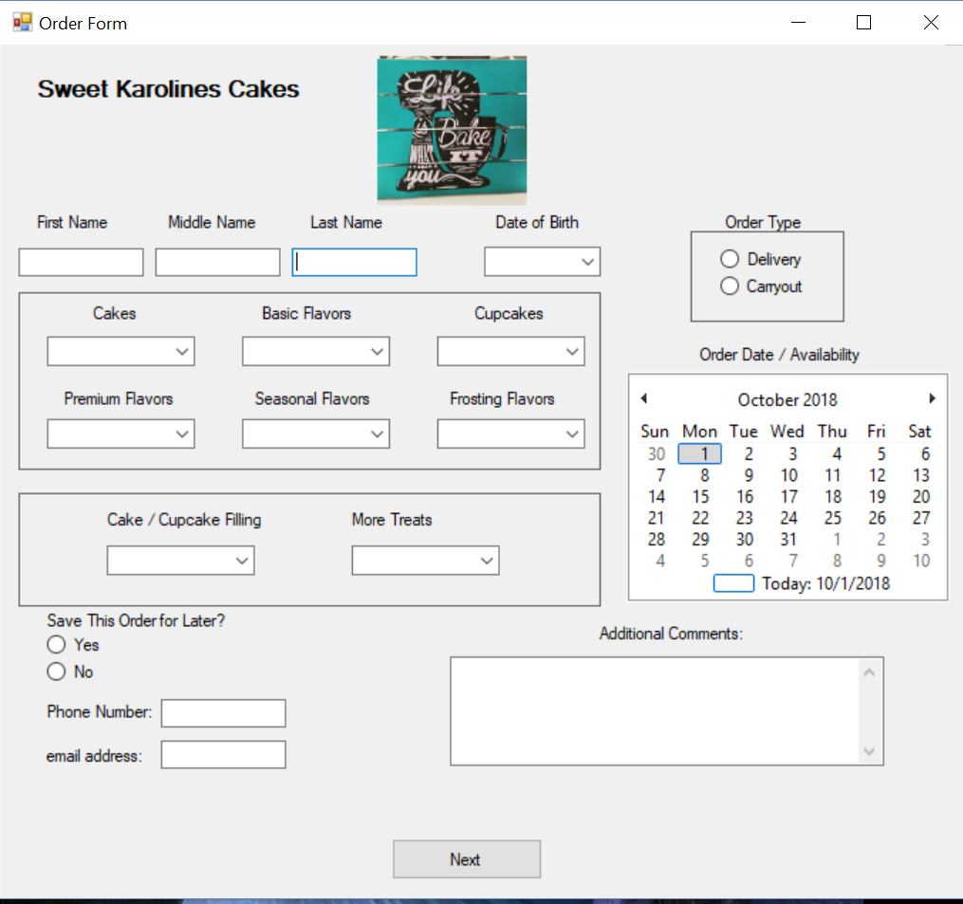
Prototype - Order Form

Slide 7
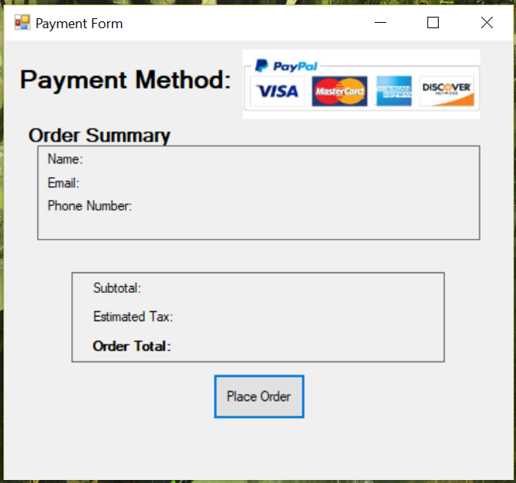
Prototype - Payment Form

Slide 8
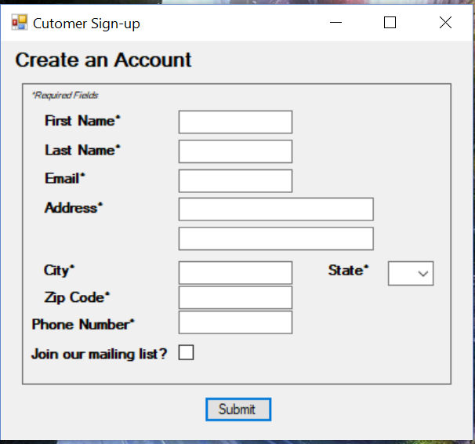
Prototype - Account Set Up

Slide 9
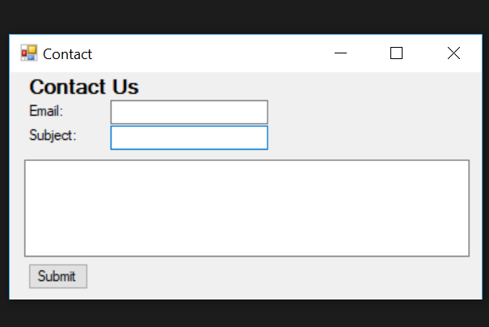
Prototype - Contact Form

Slide 10
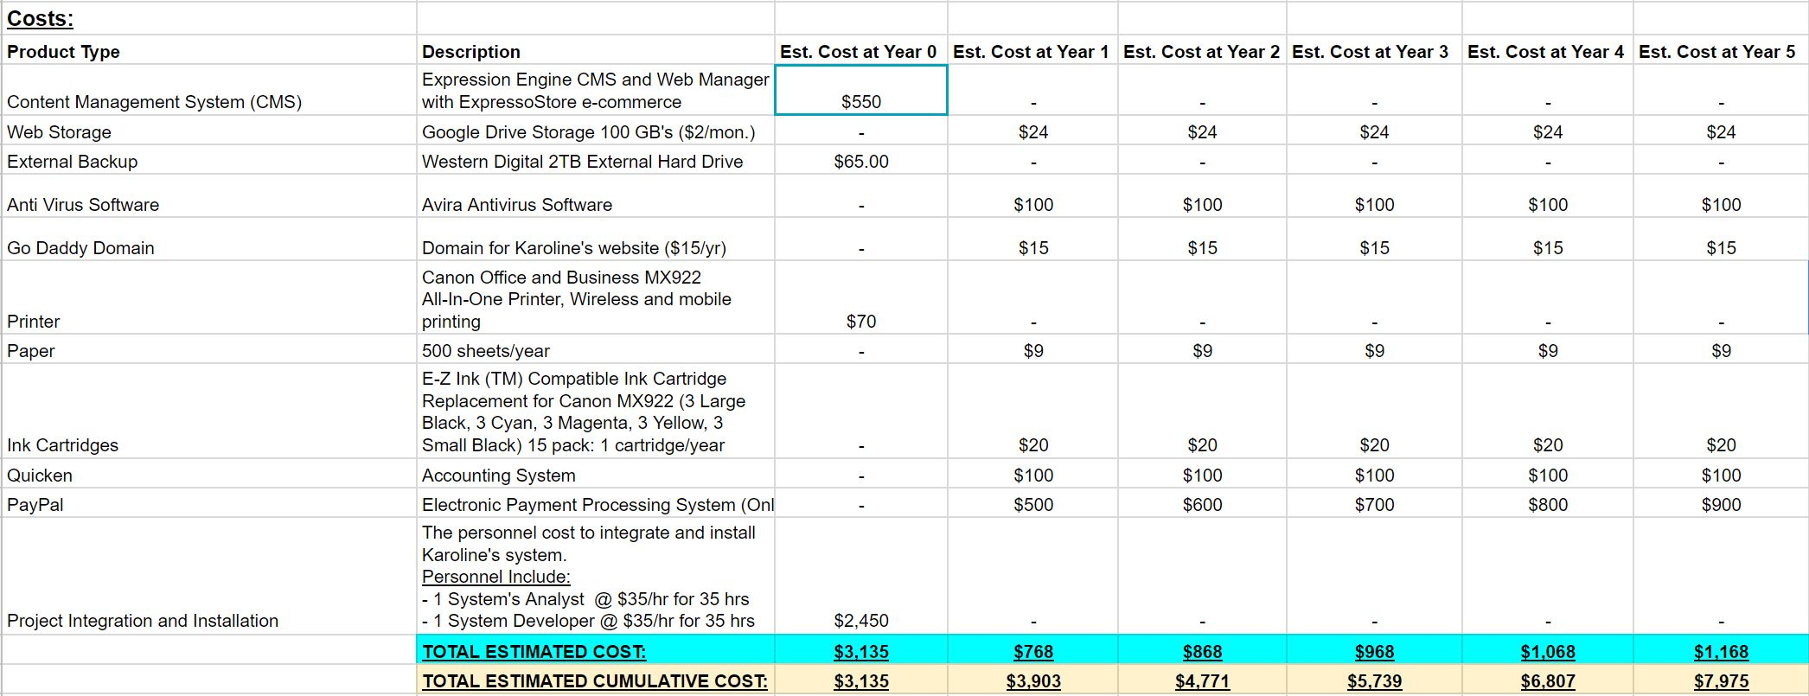
Feasibility Analysis - Costs

Slide 11
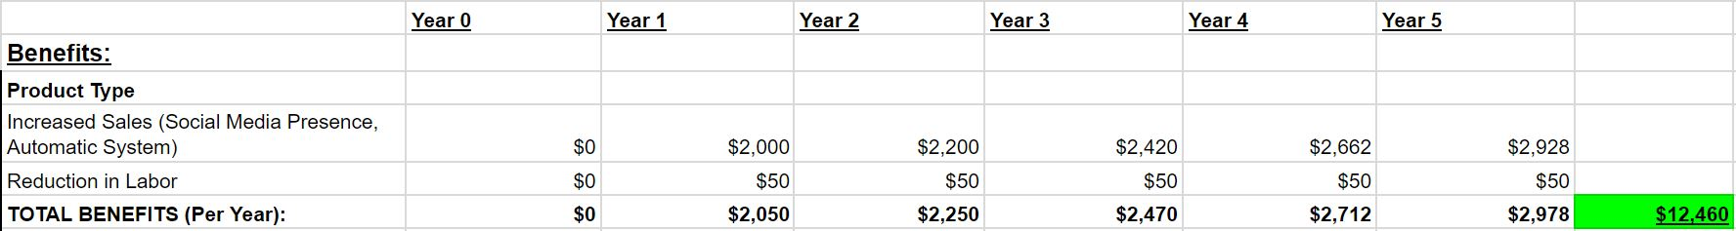
Feasibility Analysis - Benefits
Notes:
INCREASED SALES HAS A 10% INCREASE EACH YEAR AFTER YEAR 1

Slide 12
Important Numbers:
Return on Investment: 36%
Break Even: Between Years 2-3
Net Present Value: $3,846

Slide 13

Questions?

